Slide 1

Project 4 – Monte carlo
Malvin Varpe &
Torgrim Odde
Notes:
I will start, Malvin will cover the second part and conclude project 4 – our final project for this course.

Slide 2
Agenda
Governing Theory
Monte Carlo Mixing Tanks
  Option 1 – Fixed Parameters
  Option 2 – Time Varying Parameters
Validation Against ODE
Random Walk In Aquifers
  Unbiased vs Biased
  Risk Assessment
Conclusions & Learning Outcomes
Notes:
This project covers both mixing tanks dynamics and groundwater transport
The project presentation follow the project build-up and exercises
We start from a simple mass balance and build up to full stochastic simulation
Goal of the project
Use Monte Carlo to model uncertainty
Validate against deterministic ODE
Compare risk scenarios

Slide 3

Governing Theory
Single Tank Equation:
$\frac{dC}{dt}=\frac{Q_{in}}{V}C_{in}−\frac{Q_{out}}{V}C$
Analytical solution:
$C\left(t\right)=C_{ss}+\left(C_{0}−C_{ss}\right)e^{−\frac{Qt}{V}}$
Notes:
We start with a perfectly mixed single tank.
The governing equation comes from a standard mass balance, and the solution is exponential decay toward the steady-state determined by inflow concentration
Monte Carlo should match it in expectation, we will come back to that later on.

Slide 4
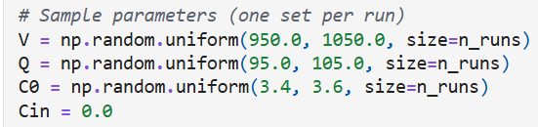
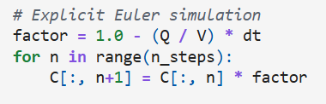
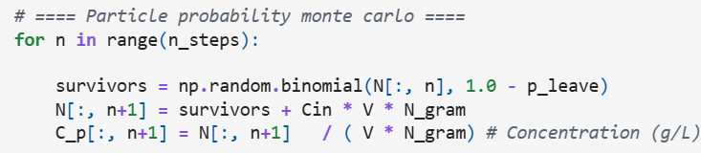
Monte Carlo Mixing Tanks
Option 1:
Fixed parameter per run
Option 2:
Parameters vary each step
Outputs: Mean, Confidence Interval, Standard Deviation
Notes:
Monte Carlo concept
We have uncertainty from volume (V), flow (Q) and initial concentration
We then repeat the simulation many times, sample parameters and compute
Mean, Standard deviation and Confidence Intervals
As a result, we get not only a prediction, but also the range of outcomes
In our project, Monte Carlo is used to propagate parameter uncertainty with two methods
Option 1: each run has fixed parameters (and we simulate for 100 runs, 1000 steps)
What’s important to mention is that we introduced the particle probability and used this for simulating the best and most realistic results
The code snippets show how we implement the Particle Probability, Explicit Euler and set Sample parameters

Slide 5
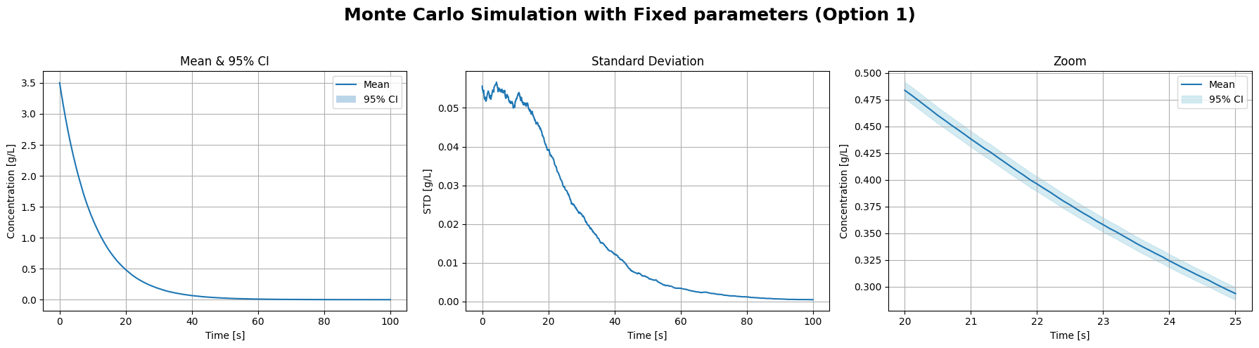
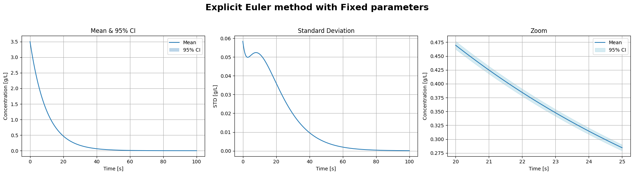
Notes:
Here, we showcase the Monte Carlo simulations (with particle probability) next to the “perfect” explicit Euler
What we can see from the plot
The mean closely follow the analytical decay (purely exponential), showing robustness of the system
The particle Monte Carlo adds sampling noise to the simulations
The confidence intervals are very narrow (which is why we zoom in on plot 3 iot visualize it)
Uncertainty at this stage is dominated by
Initial concentration and decay rate

Slide 6
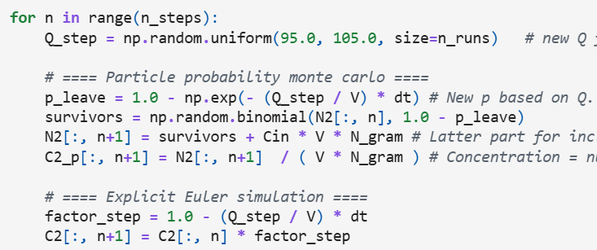
Monte Carlo Mixing Tanks
Option 1:
Fixed parameter per run
Option 2:
Parameters vary each step
Outputs: Mean, Confidence Interval, Standard Deviation
Notes:
Option 2: flow rates vary dynamically
We resample flow rate Q(t) at every time step
Volume and initial concentration are till fixed

Slide 7
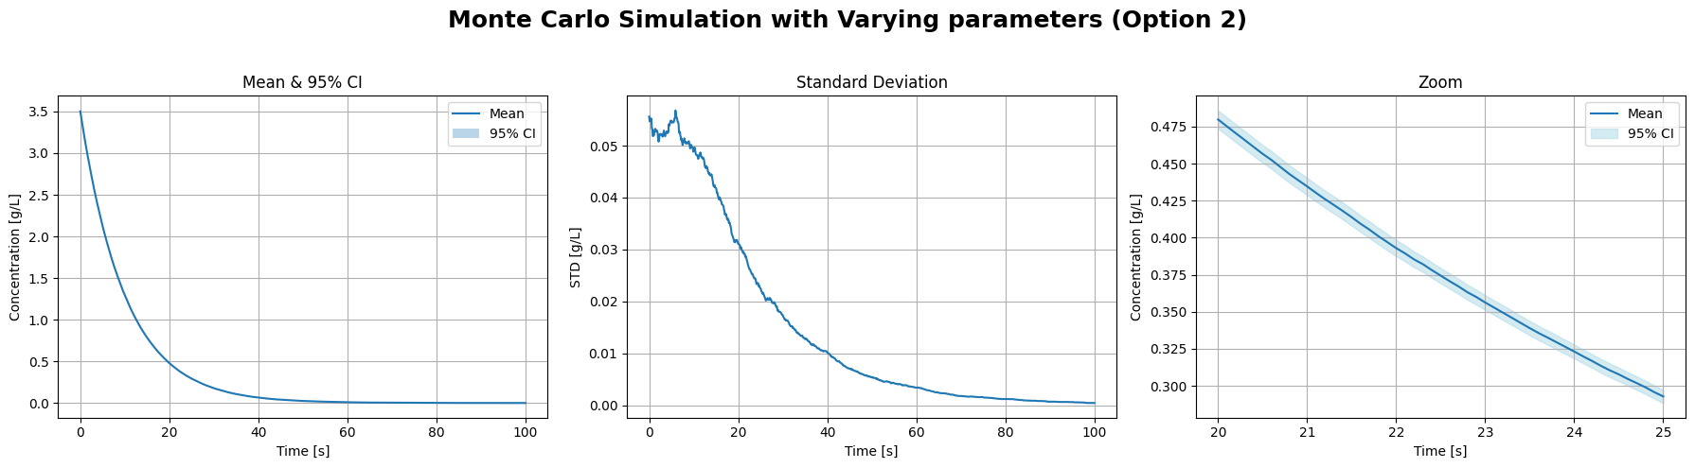
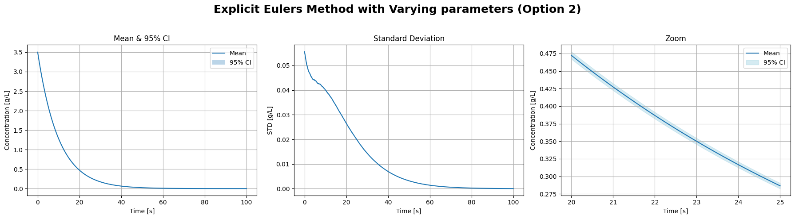
Notes:
Again, we compare the Monte Carlo simulation with the explicit Euler
What we can see from the plot
Both means closely follow the analytical decay (purely exponential), showing robustness
Again, the key difference lie in the standard deviations
Even with fluctuation flow, the average behavior is close to identical
Uncertainty changes slightly

Slide 8
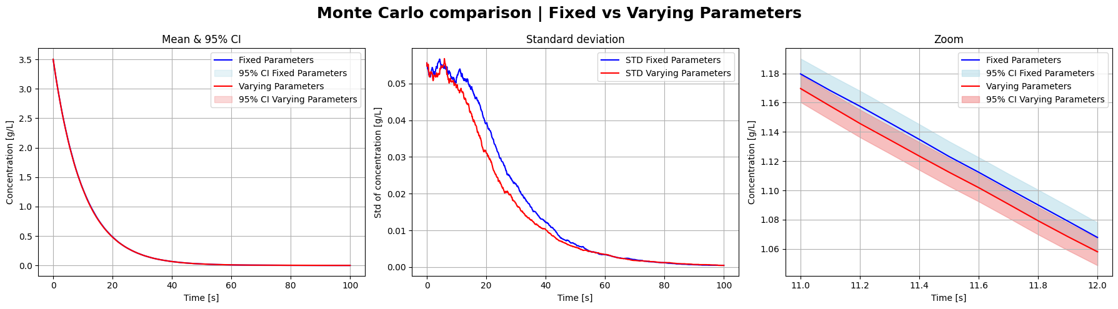
Monte Carlo Fixed Vs Varying
Notes:
To better compare the two, we can show them on the same graph
The means are identical
The STD changes slightly
Again, particle adds sampling noise

Slide 9
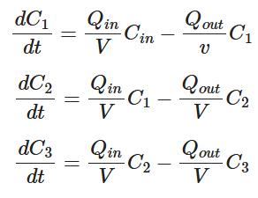
Three Tank Governing Equations
Delay & Decay
Upstream Tank Affects Downstream
Notes:
The second tank is affected by the first
The third tank is affected by the 2nd

Slide 10
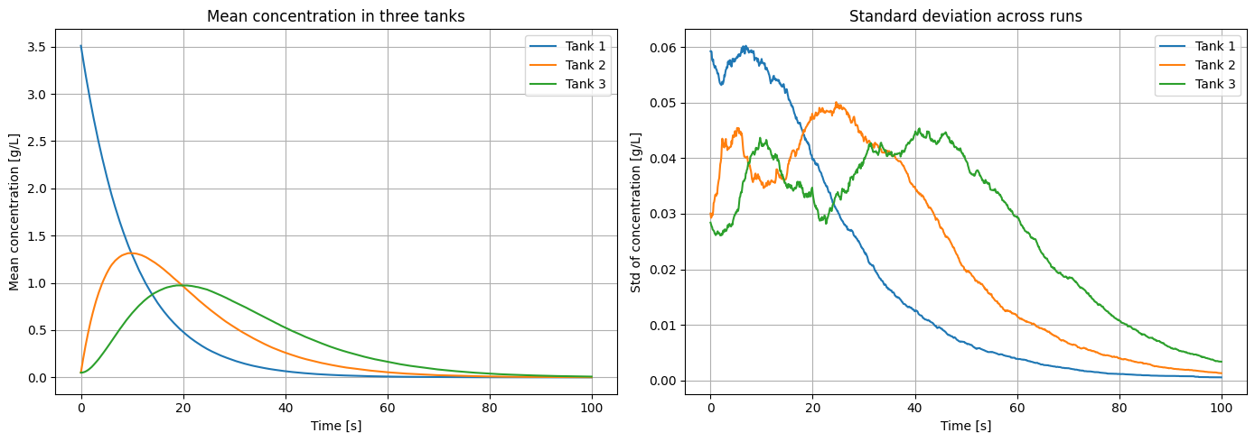
Notes:
Again, we use the particle probability Monte Carlo for our simulations

Slide 11
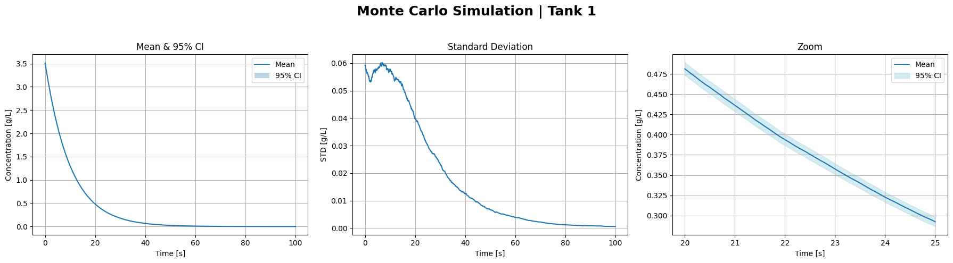
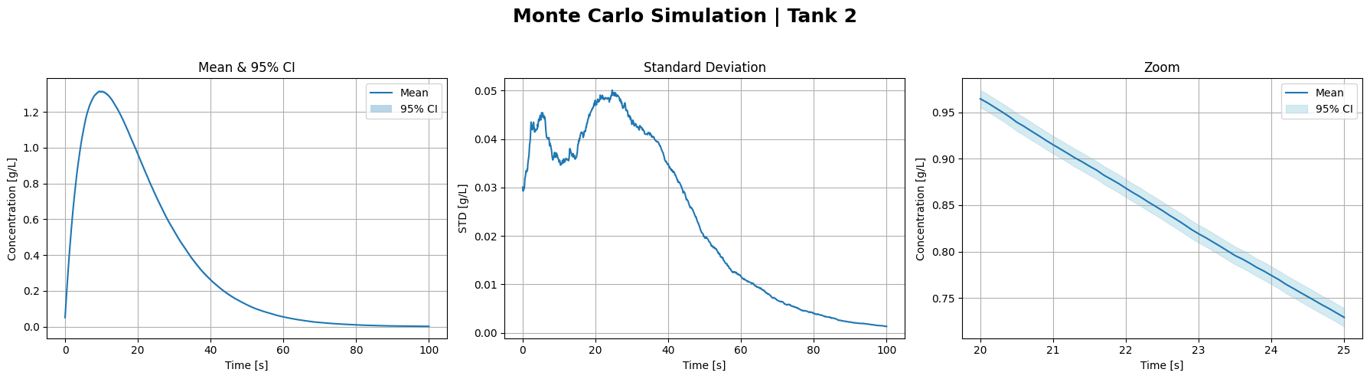
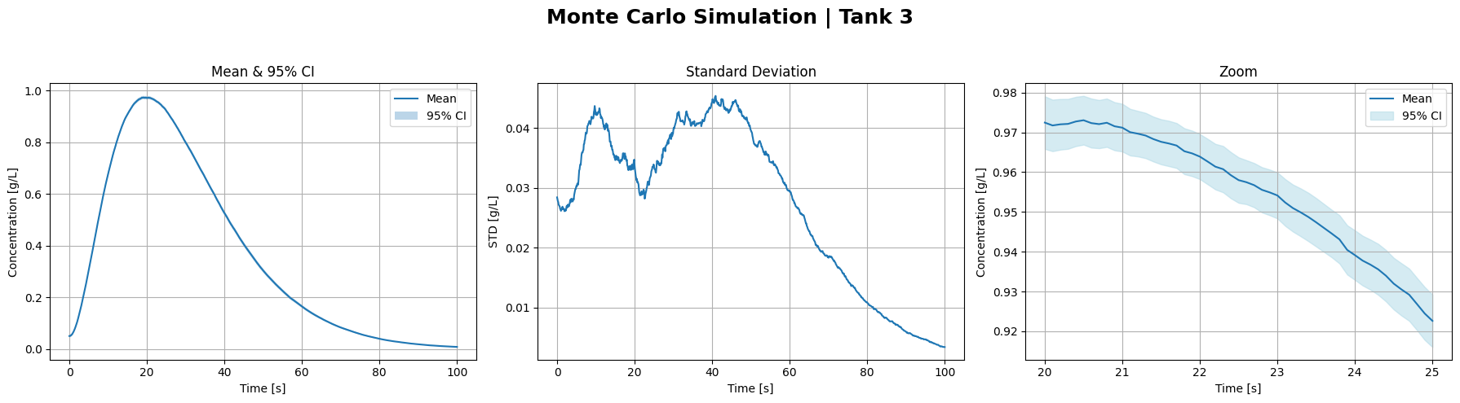
Notes:
Here, we clearly see ow the latter tank affects the previous
Means have a peak (later and later)
NB: Magnitude decreases downstream
STD has later and higher peaks based on flow from previous tank (and initial concentration in own tank)

Slide 12
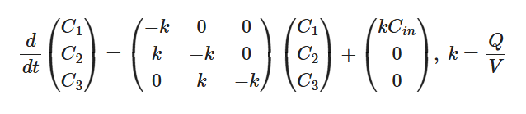
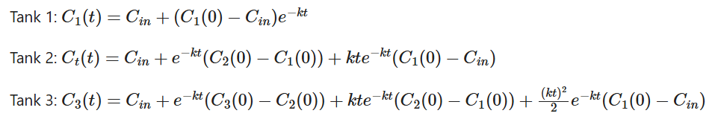
Analytical ODE Validation
Notes:
We solve a 3x3 linear system to find our constants for the three tanks:
Tank 1 is exponential
Tank 2 has added te^-kt
Tank 3 has added te^-kt and t^2e^-kt

Slide 13
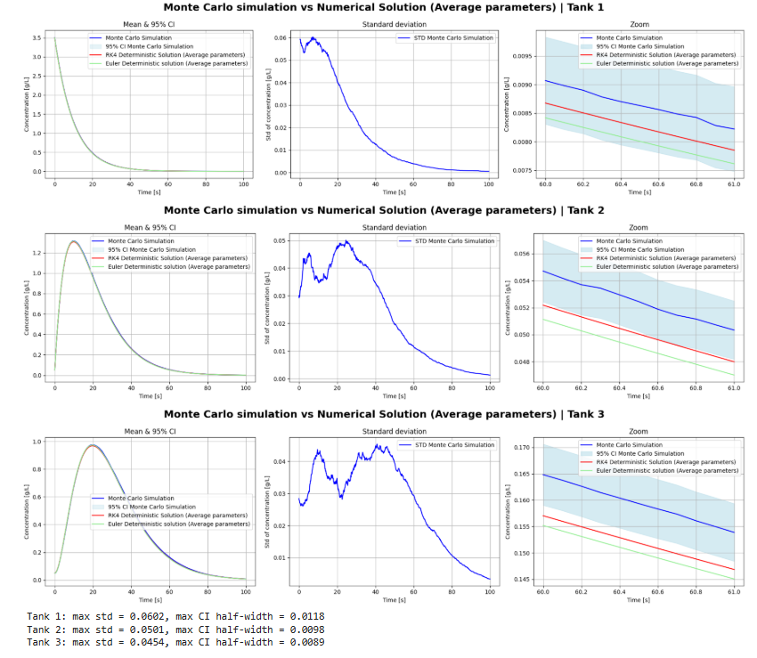

Slide 14
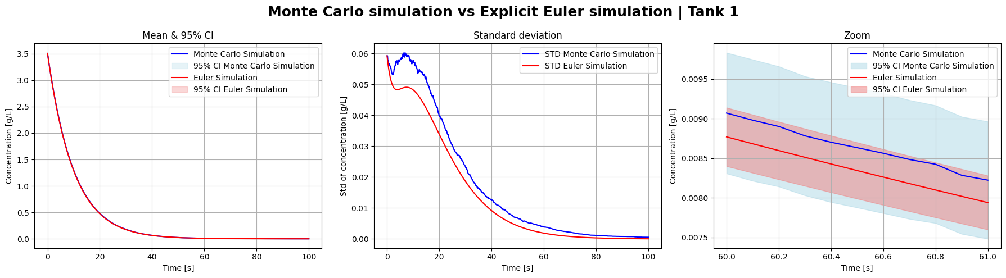
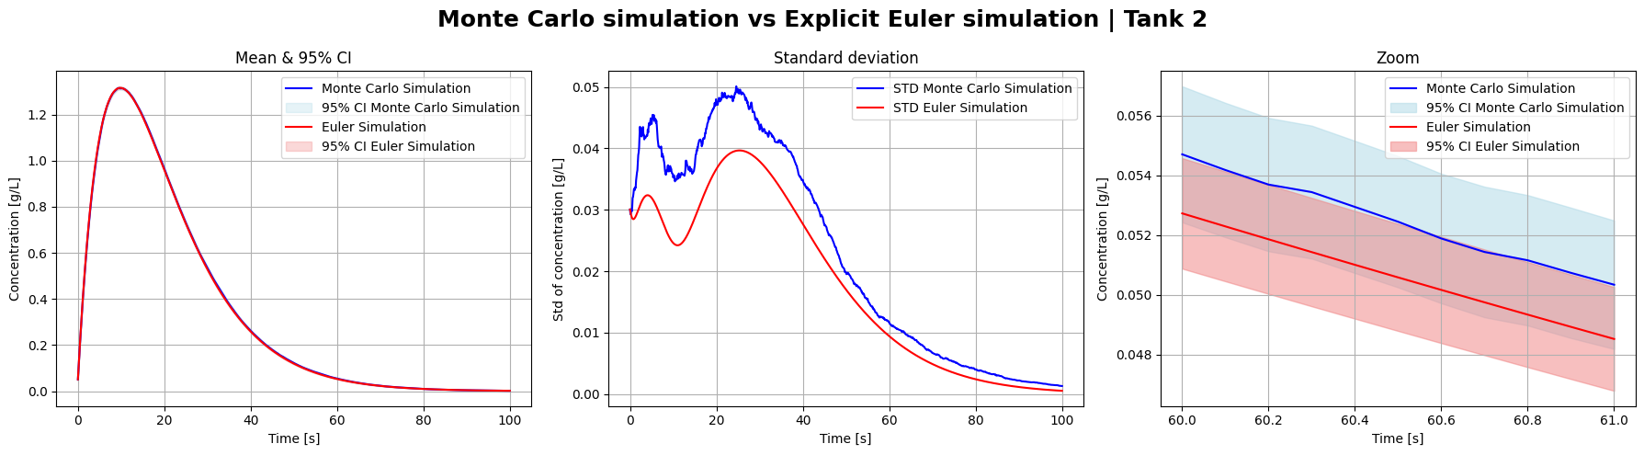
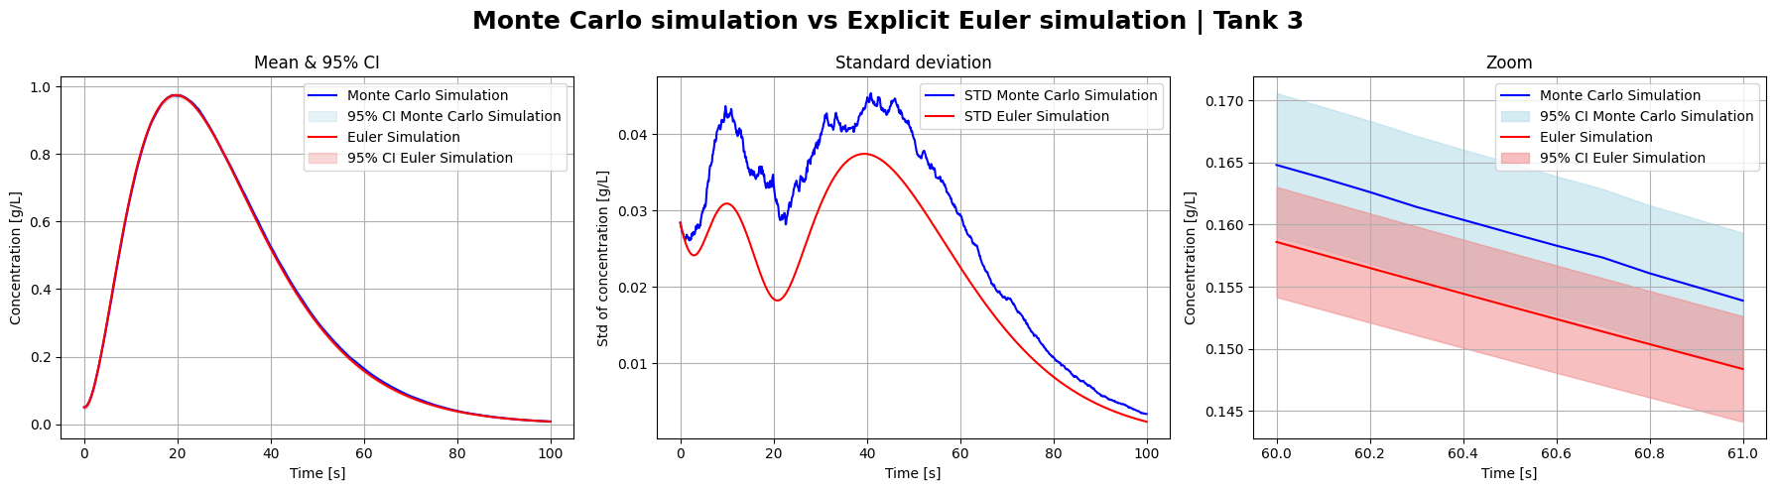
Notes:
Mean curves are visually identical
Differences only in STD
Follow expected behavior of 3 tank system, where latter tank inherits from prior tank
Some deviations from the Explicit Euler, but these differences are minor
Again, this confirms the correctness of our simulations

Slide 15

Accuracy & Computational Efficiency
Monte Carlo Mean $≠$ Deterministic ODE with average parameters
Unbiased Estimator
Variance Decays Over Time
Cost
  Deterministic: 1 Solve
  Monte Carlo: 100 Solves
Notes:
We therefore gain uncertainty quantification at the expense of runtime

Slide 16
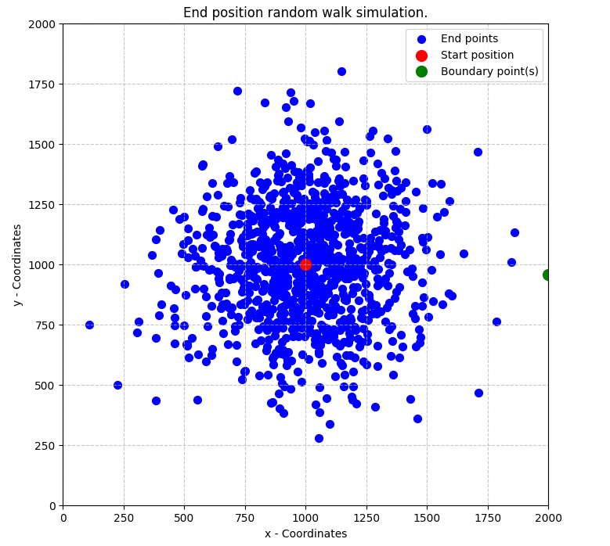
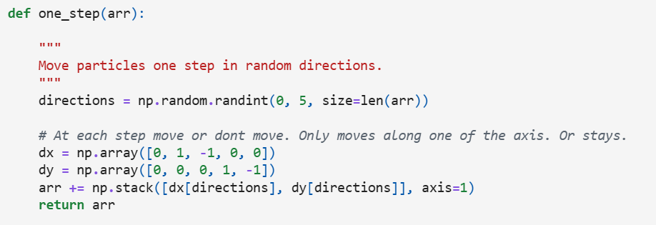

2D random walk model: basic and probability-weighted movement
Basic Random Walk Model
  Simulates 1000 particles moving stepwise on a grid without diagonal moves, stopping at set boundaries.
  Runs the function underneath for each step. Minimizing computational cost with NumPy vectorization and operations.
  Stops at around $150 000 −200 000$ iterations.
Notes:
Simulates 1000 particles moving stepwise on a grid without diagonal moves, stopping at set boundaries.
Runs the function underneath for each step. Minimizing computational cost with NumPy vectorization and operations.
Stops at around $150 000 −200 000$ iterations.

Slide 17
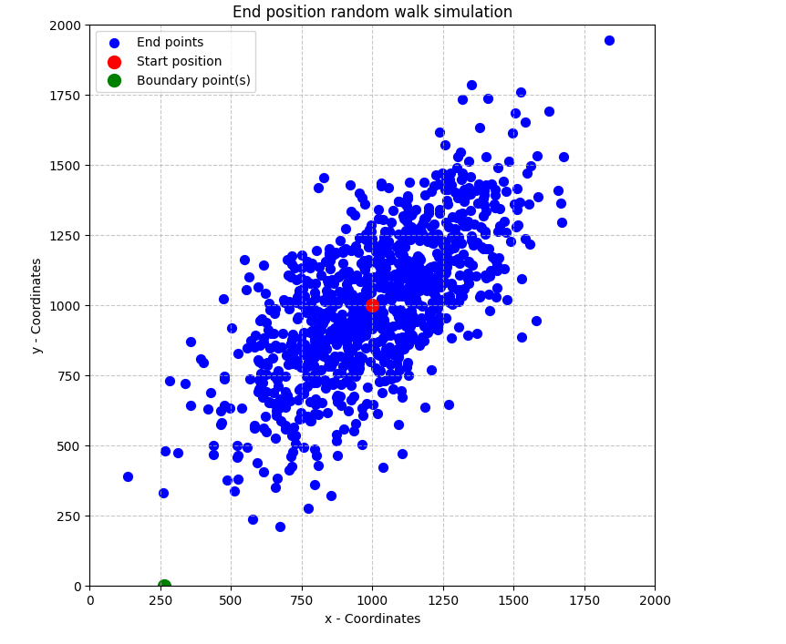
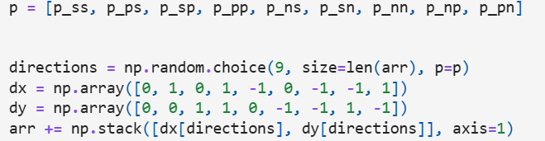
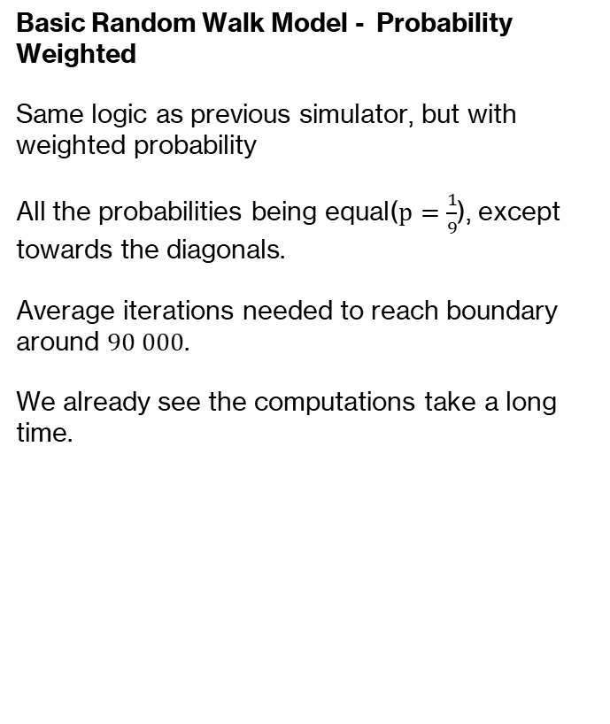
2D random walk model: basic and probability-weighted movement
Basic Random Walk Model - Probability Weighted
  Same logic as previous simulator, but with weighted probability
  All the probabilities being equal($p=\frac{1}{9}$), except towards the diagonals.
  Average iterations needed to reach boundary around $90 000$.
  We already see the computations take a long time.

Slide 18
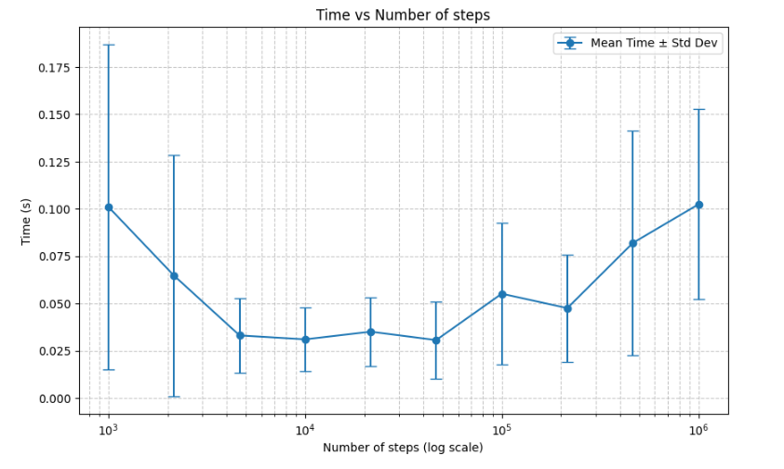
Optimization of code
We are going to see more steps and implement a chunk size simulator along the path.
Will speed up because we are reducing overhead and using vectorized operations on more numbers.
Too large chunks gives RAM-issues and slow down computations.
Time vs Numbers of steps per chunk
Notes:
In the next tasks we see that we are going to simulate when a walker first reaches a certain boundary, and not the first of many reaches. This will increase the number of steps needed dramatically. Therefore, we implement a chunk size simulator, that simulates chunks along each path, where we use a for loop for each run instead of for each step. This will decrease the computational cost, because we are reducing overhead and using vectorized operations on more numbers. Too large chunks gives RAM issues and slow down operations, and we therefore run a code simulating a few runs for different chunk sizes. Here we find that the run times are varying drastically, which indicates a high variation in the arrival times. The chunk sizes between 10 000 and 50 000 give the lowest time used per run.

Slide 19
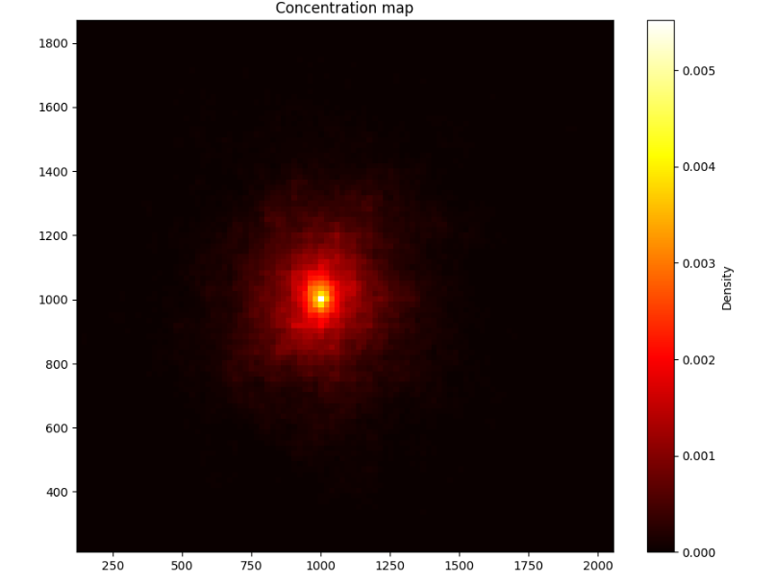
Random Walk Model of Contaminant Transporting Aquifers (Unbiased)
Simulate 150 000 years for 500 walkers and record the trajectories.
Probability that the contaminant visited a grid cell a random year
Notes:
Next we simulate 150 000 years for 500 walkers and record the trajectories. Then we plot the points in a heat map. Here we can interpret the plot as the probability that the contaminant visited a certain grid cell a random year. The probabilities are very low

Slide 20
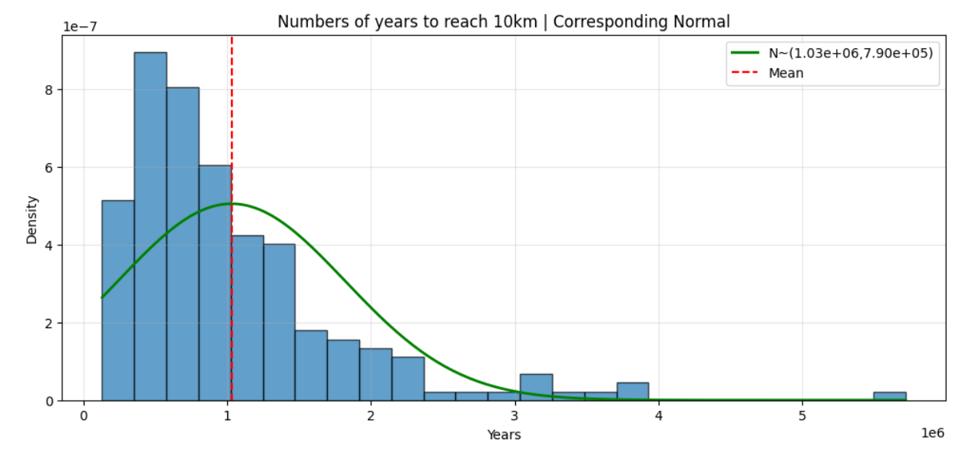
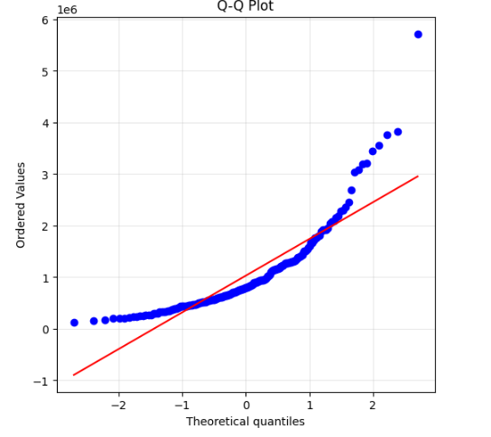
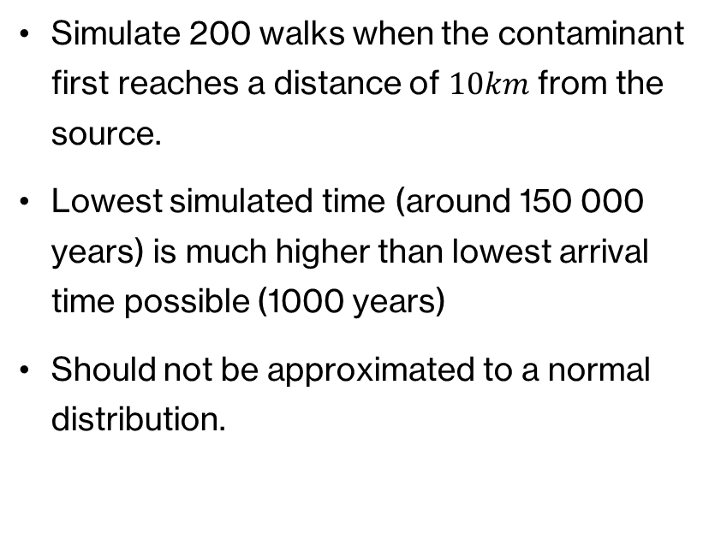
Random Walk Model of Contaminant Transporting Aquifers (Unbiased)
Simulate 200 walks when the contaminant first reaches a distance of $10km$ from the source.
Lowest simulated time (around 150 000 years) is much higher than lowest arrival time possible (1000 years)
Should not be approximated to a normal distribution.
Notes:
We then simulate when a contaminant first reaches a distance of 10km from the source. The lowest simulated time is around 150 000 years, and is substantially higher than the lowest possible arrival time of 1000 years. Becuase of the heavy tails and that the plot is not a straight line in the Q-Q plot, we should not approximate this to a normal distribution.

Slide 21
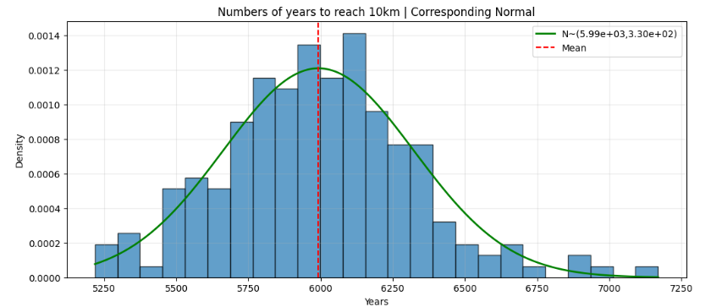
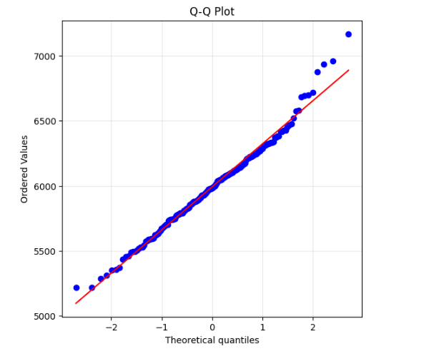
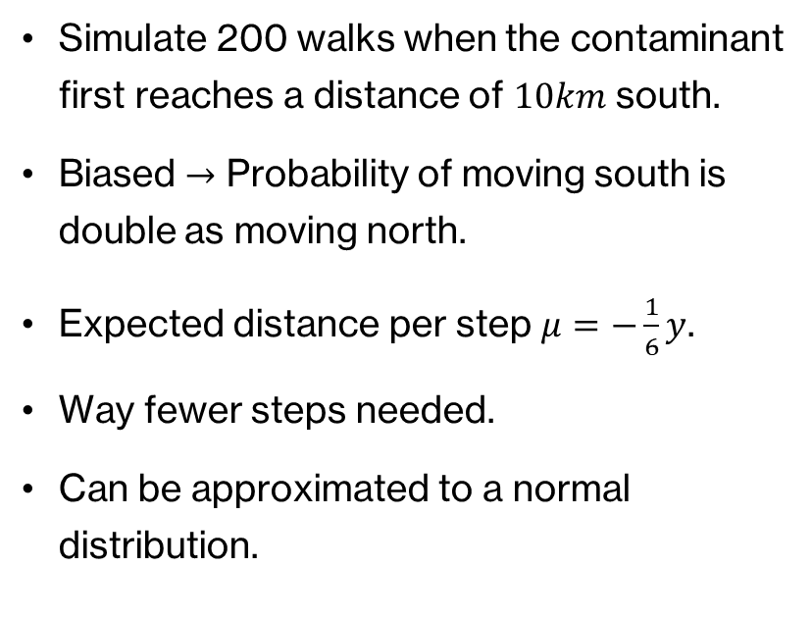
Random Walk Model of Contaminant Transporting Aquifers (Biased)
Simulate 200 walks when the contaminant first reaches a distance of $10km$ south.
Biased $→$ Probability of moving south is double as moving north.
Expected distance per step $μ=−\frac{1}{6}y$.
Way fewer steps needed.
Can be approximated to a normal distribution.
Notes:
We then create a biased simulation where the probability of moving south is double the probability of moving north, with 200 walks and stopping when the contaminant reaches 10 km south, or y=0. By calculating the average weight of each step, we can see that the contaminant moves on average 1/6th of a y-value towards the south. This means that to reach the south border it needs on average 6000 years.
This is confirmed by the simulation where we can see the plot of arrival times on the right.
We can also approximate this as a normal distribution, mostly because of the central limit theorem and the large average value towards the south. This is also confirmed by the plots on the right.

Slide 22
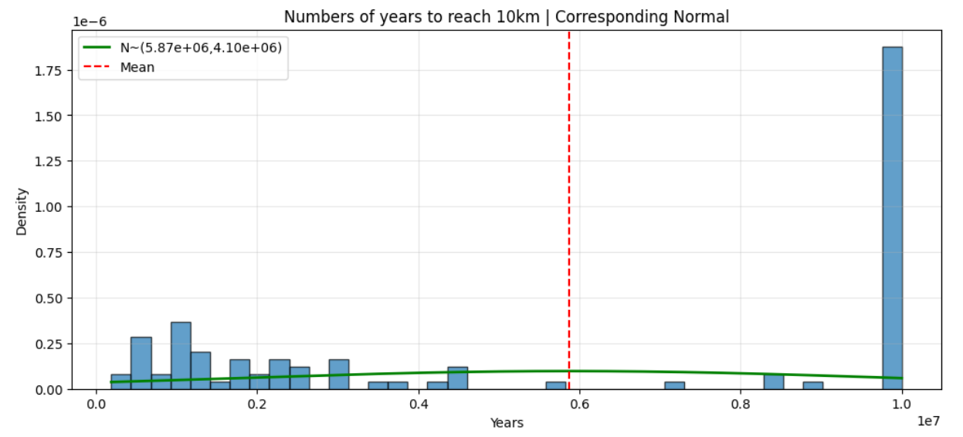
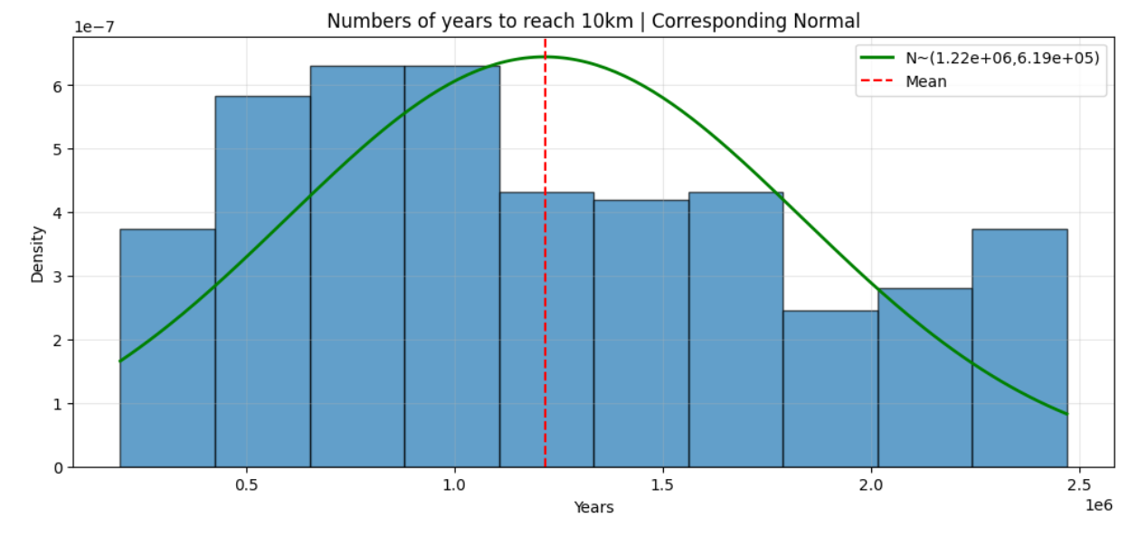
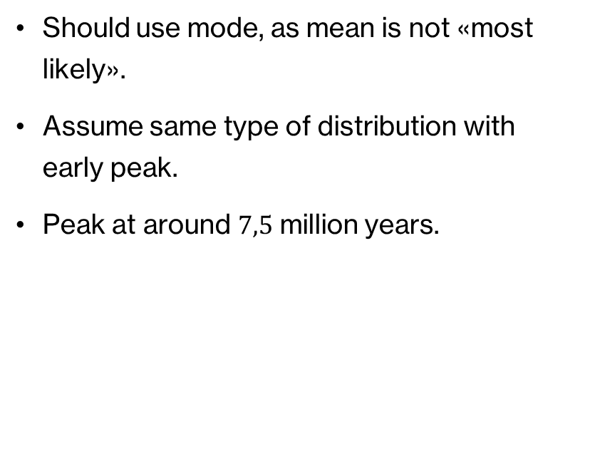
To reach 10km south (Unbiased)
Should use mode, as mean is not «most likely».
Assume same type of distribution with early peak.
Peak at around $7,5$ million years.
Notes:
Lastly we try to compare the most likely arrival times south for unbiased vs biased. We use the mode for the most likely arrival times, as it does not make sense using the mean when the distribution is so skewed and with the high variance.
We assume the distribution is of the same characteristics as the first unbiased random walk, just that it is way more spread out. We also assume that it has an early peak as that distribution also has.
To make it computationally easier we run the simulation two times, where we stop the simulation first at ${10}^{7}$ to find around what point the peak is, and the second time at $2,5⋅{10}^{6}$. The first plot has a large value at ${10}^{7}$ because this is where we stop the simulations. We can see from the plots that the peak is not easily defined, but we approximate it to be around 7,5 million years. We can also read from the plots that the peak is very low compared to the full distribution, indicating that the spread is very wide.

Slide 23

Risk Comparison
Unbiased Vs Biased
Risk Interpretation
  Downward Stream = High Risk
  Upward Stream = Negligible Risk
Notes:
Based on the simulated arrival times, the unbiased random walk has the most likely arrival time to the 10km boundary approximately 100 times more than the biased walk. This does not even account for the enormous variation in the arrival times and low probability of early arrival of the unbiased walk compared to the biased walk. We see that all biased arrivals occur in less than 7000 years , while the unbiased walk has almost half the arrival times above 10 million years. These arrival times would also be spread out a lot reaching very large values for the unbiased random walk.
The simulations illustrate how directional groundwater flow strongly increases contaminant transport speed. In a real aquifer, a hydraulic gradient or pumping well would create this type of bias, dramatically increasing contamination risk downstream. In contrast, purely diffusive transport without flow would pose little risk on engineering timescales.
In practical terms, the biased walk represents advective transport driven by flow, where contaminants consistently migrate in one direction and reach the boundary on a predictable timescale. In contrast, the unbiased walk represents more diffusive behavior, where boundary crossings are rare, extremely delayed, and dominated by random fluctuations. Therefore, contamination risk is dramatically higher in the biased case.

Slide 24
Conclusion & Learning Outcomes
Key Results
  Monte Carlo Reproduce ODE Means
  CI Quantify Uncertainty
  Directional Bias Drastically Increases Contamination Speed
Summary
  Deterministic ODE
    Fast & Accurate
  Monte Carlo
    Expensive But Informative
Notes:
The simulations show that for simple systems, the Monte Carlo methods reproduce deterministic behaviour on average while also revealing how uncertainty evolves in time and space. For the single tank, the mean concentration followed the analytical exponential decay almost exactly, and the standard deviation behaved as expected. In the three-tank system, the mean and variability shifted downstream, demonstrating how uncertainty spreads through interconnected tanks. While deterministic ODE predictions aligned closely with the Monte Carlo mean curves, they failed to capture the complexity introduced by variable parameters for the three-tank system.
The 2D aquifer model showed much stronger effects of randomness. Unbiased random walks produced broad spreading and extremely long arrival times (on the order of one million years), while introducing a directional bias reduced arrival times by more than two orders of magnitude. These results show how stochastic simulations capture both average behaviour and the range of possible outcomes, making them valuable tools when system parameters or transport paths are uncertain.

